Slide 1


Training Test on Information Technology (IT)
http://schoolacademy.telerik.com
[team MANGO]
[]

Slide 2


Computer Systems
Hardware questions

Slide 3
Computer Systems (Hardware)
This section consists of the following questions:
Computer Systems
Main components of computer systems, features, characteristics, interaction
Fundamental work principles
Fundamental input-output interfaces and standards

Slide 4
Question
RAM stands for:
Read Access Memory
Real Address Memory
Random Access Memory
Random Address Memory

Slide 5
Answer
Information:
Random-access memory (RAM /ræm/) is a form of computer data storage. A random-access device allows stored data to be accessed directly in any random order. In contrast, other data storage media such as hard disks, CDs, DVDs and magnetic tape, as well as early primary memory types such as drum memory, read and write data only in a predetermined order, consecutively, because of mechanical design limitations. Therefore, the time to access a given data location varies significantly depending on its physical location.
Source: Wikipedia

Slide 6



Computer Systems
Computer Software

Slide 7
Computer Programs (Software)
This section consists of the following questions:
Computer Programs (Software)
Nature, functions, classification
Creation
Types of use (installation, start-up, uninstallation)

Slide 8
Question
What are the two main types of software that you would find in a computer system?
Embedded software and plug-ins
Utility software and application software
System software and application software
System software and programming software

Slide 9
Answer
Information:
The two main types of software that you would find in a computer would include system software and application software. System software controls the computer's internal operations. It includes device drivers and window systems. Application software tells the computer what to do to solve practical problems. This would include video games, word processing and spreadsheets.
Source: www.buzzle.com

Slide 10



Rules for working with and supporting computer systems
Installation, Utilisation, Maintenance, …

Slide 11
Working with Computer Programs
This section consists of the following questions:
Rules for working with computer systems and programs
Start-up and shut-down
Diagnostics
Problem detection
Maintenance
Testing

Slide 12
Question
Which of the following is NOT a program for system information and diagnostics?
AIDA64
Hiren's BootCD
GIMP
Belarc Advisor

Slide 13
Answer
Information:
GIMP (GNU Image Manipulation Program) is an image retouching and editing tool.
AIDA64 is a system information, diagnostics, and auditing program that runs on Microsoft Windows operating systems. http://www.aida64.com
Hiren's BootCD (also known as HBCD) is a bootable software CD containing a number of diagnostic programs. http://www.hirensbootcd.org
The Belarc Advisor builds a detailed profile of installed software and hardware, missing security patches, anti-virus status, and NIST SCAP security configurations (USGCB, FDCC) and displays the results in a Web browser. http://www.belarc.com

Slide 14

Means of Data Transfer in IT and Numeral Systems
Channels of Data Transfer, Measurement Units, Numeral Systems

Slide 15
Data Transfer. Numeral Systems
This section consists of the following questions:
Means of IT data transfer (different approaches and methods, physical environments and transfer channels, advantages and disadvantages)
Basic information measurement units
Fundamentals of binary calculations
Calculation in different numeral systems

Slide 16
Question
Which of the following is NOT true about numeral systems?
Numeral systems are a way of representing numbers by a finite type-set of graphical signs called digits.
The characters, which are used to depict numbers in a given numeral system, can be perceived as that system’s alphabet.
Beside an alphabet, every numeral system has a base.
The base is a number not equal to the different digits used by the system for depicting the numbers in it.

Slide 17
Answer
Information:
The correct answer is: d) The base is a number not equal to the different digits used by the system for depicting the numbers in it. The true statement is that the base is a number equal to the different digits used by the system for depicting the numbers in it.
Source: Wikipedia

Slide 18





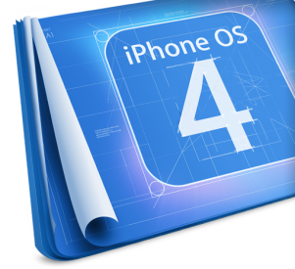









Operational Systems
Architecture, Processes, Users, User Interface, File Systems

Slide 19
Operational Systems
This section consists of the following questions:
Operational systems – concepts, main functions and tasks. User interface – concepts, types. Graphical interface – concepts, main objects, main operations, organisation, settings. File – concepts, characteristics. File systems – concepts, types, logical and physical organisation, main objects and actions. Users, processes, multitasking.

Slide 20
Question
Which of the following is not the kind of file system?
FAT
NTFS
EXT
PAAS

Slide 21
Answer
Information:
One of the possibility models for cloud computing is PAARS. In this model the users of the cloud hire both infrastructure and software applications, hosted on the cloud to produce their own applications.
Source: Wikipedia

Slide 22

Software Engineering
Analysis, Specification, Design, Prototype, Implementation, Testing, Maintenance, …

Slide 23
Software Engineering
This section consists of the following questions:
Main phases of project implementation – analysis, modeling, design, prototype creation, implementation, verification (testing and quality assurance), improvement and refining, documentation, tracking. Modeling methods. UML. Validity assessment of project implementation. Planning and management of projects.

Slide 24
Question
Arrange the phases of making a software product in chronological order: A-Implementation; B-Planning; C-Defining the task; D-Deploying the product; E-Debugging:
A,B,C,D,E
B,A,C,D,E
C,B,A,D,E
B,A,C,E,D

Slide 25
Answer
Information:
There are several different approaches to software development, however most methodologies share the same steps. First you need to know what exactly you will make and what problem will you solve. So defining the task is the first step. Then you need to break the problem into smaller pieces and plan the solving of every piece. Then comes the implementation part (writing the code). After you have written the code, you need only to check for mistakes and debug the program if it's not working properly. The final step is deployement and maintenance if your software is for customers.
Source: Wikipedia

Slide 26




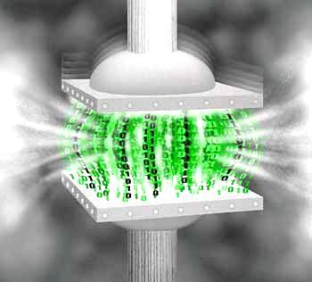




Compressing and Decompressing Data
Compressing algorithms, archive software

Slide 27
Data Compressing
This section consists of the following questions:
Compressing and decompressing of data. Coding with and without loss. Linear prediction coding. Shannon-Fano’ and Huffman’s algorithms. Arithmetical coding. Dictionary coding: LZ-77 and LZW. JPEG coding. Archiving programs – working with WinZIP and WinRAR. Creation and principle of operation of self archiving and installing archives.

Slide 28
Question
Which of the following formats is not compressed?
RAR
JPEG
DOCX
WAV

Slide 29
Answer
Information:
WAV – is short for “Waveform Audio File Format”
Standard digital audio file format used for storing waveform data; allows audio recordings to be saved with different sampling rates and bitrates; often saved in a 44.1 KHz, 16-bit, stereo format, which is the standard format used for CD audio.
Source: www.fileinfo.com

Slide 30



Text Processing
Text Processing software, File Formats, Coding, Text, Tables, Figures, …

Slide 31
Text Processing
This section consists of the following questions:
Computer processing of texts
Types of file formats (TXT, DOC, DOCX, RTF), conversion
Ways of text information coding (coding tables and Unicode standards, Windows-1251, ASCII)
Multilingualism guarantee problems

Slide 32
Тext Processing (2)
Main components of text layout (paragraphs: justifying, space and paragraph lining, text: fonts, symbol space, painting, font size, effects). Standards for text design. Styles. Images and symbols import. Tables import. Design of tables, rows/columns, cells. Text fields import. Figure drawing. Page formatting: frame, background. New page and section import, numbering, contents.

Slide 33
Question
Which of the following is a text editor
Flex
Felix
Cream
Perl

Slide 34
Answer
Information:
Cream is a configuration of the Vim text editor that consists of a set of scripts which can be run within Vim to make it behave more like an editor now common to most personal computers which conform to the Common User Access standards of interface and operability.
Source: Wikipedia

Slide 35
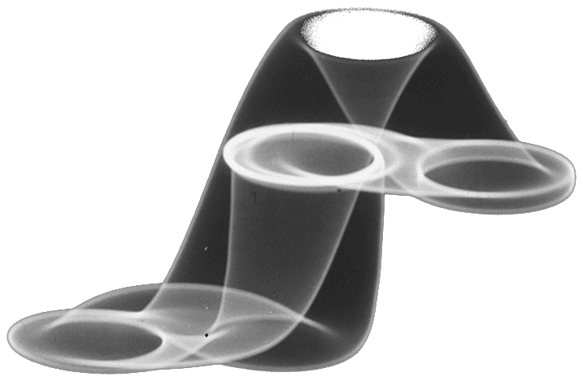



Computer Graphics
Raster and Vector Graphics, Graphic File Formats, Graphic Editors, Color Schemes

Slide 36
Computer Graphics
This section consists of the following questions:
Computer graphics. Graphic file formats (JPG, GIF, PNG, TIFF, EPS, PSD, AI, CDR). Images compression. Vector and graphic images. Graphic files conversion. Applications (design of graphical images, image recognition and analysis, computer artistry). Image graphical editors. Filters and effects. Color schemes: RGB, CMYK, Panton, 16-bit colors.

Slide 37
Question
Which statement associated with vector graphics is NOT true?
The image is composed of pixels
High image quality in different degrees of scaling
The images are constructed from basic geometric shapes (square, circle, line, etc.), which are described with mathematical formulas and equations.
Not suitable for images with subtle shading colors

Slide 38
Answer
Информация:
The vector graphics is computer method for representing digital images, in which the images are described using math formulas, functions, vectors.
The vector graphics isn’t an alternative for the raster graphics, because they both have different purpose and assignment. The raster graphics is better for photographic pictures and in situations, in which the visualization method of the vector graphics will not be useful or will be too slow.
Source: Wikipedia

Slide 39






Databases
Database Models, Tables, Relations, SQL

Slide 40
Databases
This section consists of the following questions:
Databases. Database management systems. Logical and physical organisation. Database models
Relational databases. Tables and relations. Database objects. Data types
SQL language. SQL commands and requests

Slide 41
Question
With SQL, how can you return the number of records in the "Persons" table?
SELECT COUNT() FROM Persons
SELECT COUNT(*) FROM Persons
SELECT COLUMNS(*) FROM Persons
SELECT COLUMNS() FROM Persons

Slide 42
Answer
Information:
The COUNT(expression) function returns the number of rows that matches a specified criteria.
Source: www.w3schools.com

Slide 43

Information Systems
ERP, CRM, BI, BPM, FMIS, CAD/CAM, CMS, Software Architectures

Slide 44
Information Systems
This section consists of the following questions:
Information systems. Classification (Organisation management – ERP, production management, clients and suppliers relations – CRM, reports, analysis and predictions – BI, concrete problems solution, ...). Lifecycle (Key stages in design and use). Main functions and tasks. System architectures – dual layered (client/server), tripple layered, N-layered (distributed), cloud computing.

Slide 45
Question
Which of the following delivery models is not part of Cloud computing?
SaaS
IaaS
PaaS
Ogg

Slide 46
Answer
Information:
Ogg is only a container format. The actual audio or video encoded by a codec is stored inside an Ogg container. Ogg containers may contain streams encoded with multiple codecs, for example, a video file with sound contains data encoded by both an audio codec and a video codec.Being a container format, Ogg can embed audio and video in various formats[28][29] (such as Dirac, MNG, CELT, MPEG-4, MP3 and others).
Source: Wikipedia

Slide 47


Security and Information Protection
Symmetrical and asymmetrical coding algorithms , cryptographic hash,digital signature, digital certificates

Slide 48
Security and Information Protection
This section consists of the following questions:
Security and information protection. Coding methods and algorithms: symmetrical cryptographic algorithms – DES, 3DES; asymmetrical cryptographic algorithms (public and private keys) – RSA, DSA. Cryptographic hash algorithms – SHA-1, MD5. Digital signature. Public Key Infrastructure (PKI). Digital certificates.

Slide 49
Question
What is malware?
Harmful software, design to damage or do other unwanted things to the computer system.
A type of software, which is pre-build and is not intended to be changed.
Software, which is available for usage at no cost.
Software, designed to protect the computer from harmful software.

Slide 50
Answer
Information:
Short for malicious software, is software used to disrupt computer operation, gather sensitive information, or gain access to private computer systems. It can appear in the form of code, scripts, active content, and other software. 'Malware' is a general term used to refer to a variety of forms of hostile or intrusive software. In all countries it is a serious criminal offence to create and distribute malware, but it continues to be produced for various reasons, such as demonstrating a capability or making money.
Source: Wikipedia

Slide 51




Presentation Systems
Presentation Software, Presentations Preparation, Slides, Effects, Notes, Colors, Images, Sound, Video

Slide 52
Presentation Systems
This section consists of the following questions:
Information presentation through IT means. Computer presentation – slide, effects, notes, color scheme, templates
Presentation materials design – usage of colors, text, images, sound, animation and video
Presentation software (presentation systems)

Slide 53
Question
The most important part in giving a presentation is how you act and how you communicate with people. Only 7% of the communication between people is performed by words and their meaning. What other type of communication use people and approximately what % of the whole communication it takes?
93% of the communication is done by body language
20% by the way you speak, 73% by support resources(presentation,experiment)
38% by the way you talk and 55% by the body language
10% by the way you talk and 83% by support resources

Slide 54
Answer
Information:
Nonverbal communication is a fact. When we interact with others we continuously give and receive wordless signals. Professor Albert Mehrabian has done many and fascinating researches. One if them is about body language and non-verbal communication. Mehrabian's research provided the answer for the question about how people communicate with each other and % of the communication is by words, by your voice and by body language.
Source: www.businessballs.com

Slide 55
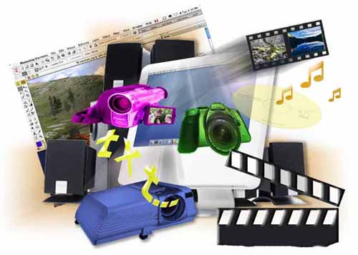



Multimedia
Multimedia Creation/Processing Software: Sound, Video, File Formats

Slide 56
Multimedia
This section consists of the following questions:
Multimedia. Technologies for creation of multimedia applications. Software recourses for creation of multimedia products. Animation and movie generation (images, sound and text incretion and processing). Multimedia files compression. Multimedia file formats conversion. Software for reproduction of multimedia products, animation and movies.

Slide 57
Question
Which of the following audio file formats is compressed without losing of quality?
MP3
WAV
FLAC
AAC
AVI

Slide 58
Answer
Information:
An audio file format is a file format for storing digital audio data on a computer system. This data can be stored uncompressed, or compressed to reduce the file size. It can be a raw bitstream, but it is usually a container format or an audio data format with defined storage layer. A lossless compressed format stores data in less space by eliminating unnecessary data. Uncompressed audio formats encode both sound and silence with the same number of bits per unit of time. Encoding an uncompressed minute of absolute silence produces a file of the same size as encoding an uncompressed minute of music. In a lossless compressed format, however, the music would occupy a smaller portion of the file and the silence would take up almost no space at all. Lossless compression formats enable the original uncompressed data to be recreated exactly.
Source: Wikipedia

Slide 59


Computer Networks
OSI Model, Network Models, Protocols, Standards, Hardware Equipment

Slide 60
Computer Networks
This section consists of the following questions:
Computer networks. OSI model architecture. Network protocols
Local networks – concepts, types according to management organisation, topology, fundamental standards, hardware components
Global computer networks – concepts, ways of connection, addresses, main services. Users and access to recourses

Slide 61
Question
What is subnetwork?
Logically visible subdivision of an IP network
Telecommunications network that allows computers to exchange data
Social network
Modern wireless network used in the subways
Hardware accessory, which hides the device’s logical address

Slide 62
Answer
Information:
A subnetwork, or subnet, is a logically visible subdivision of an IP network. The practice of dividing a network into two or more networks is called subnetting.
The benefits of subnetting vary with each deployment scenario. In the address allocation architecture of the Internet using Classless Inter-Domain Routing (CIDR) and in large organizations, it is necessary to allocate address space efficiently. It may also enhance routing efficiency, or have advantages in network management when subnetworks are administratively controlled by different entities in a larger organization. Subnets may be arranged logically in a hierarchical architecture, partitioning an organization's network address space into a tree-like routing structure.
Source: Wikipedia

Slide 63



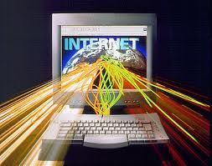
Internet Structure
Internet, Protocols, Services, WWW, HTTP, FTP, SMTP, POP3, IMAP, WebDAV, IP, DNS, …

Slide 64
Internet Structure
This section consists of the following questions:
Internet – nature, technical and technological aspects. Client-server architecture
Main services and protocols – HTTP, FTP, POP3, SMTP
Types of internet access – dial-up, ISDN, LAN, DSL/ADSL, Wi-Fi
Internet addresses – IP address, DNS services, first level domains. Hosting

Slide 65
Question
Which of the following is NOT type of Internet Access?
ISDN
DSL/ADSL
POP3
Wi-Fi

Slide 66
Answer
Information:
In computing, the Post Office Protocol (POP) is an application-layer Internet standard protocol used by local e-mail clients to retrieve e-mail from a remote server over a TCP/IP connection.
Internet access connects individual computer terminals, computers, mobile devices, and computer networks to the Internet, enabling users to access Internet services. Types - Dial-up, ISDN, DSL/ADSL, Wi-Fi and others.
Source: Wikipedia

Slide 67


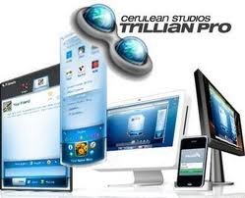


Electronic Communication
E-mail, Skype, ICQ, IRC, MSN Messenger, Yahoo Messenger, Social Networks, Forums, …

Slide 68
Electronic Communication
This section consists of the following questions:
Electronic communication
E-mail – e-mail clients and web based interfaces and protocols
Real time conversations – IRC, ICQ, Skype, MSN Messenger, Yahoo Messenger – operation principles and protocols
Social networks

Slide 69
Question
What is the common between AOL Mail, Gmail, Outlook.com and Yahoo! Mail?
They are examples of email client
They are examples of Post Office Protocol (POP3)
They are integrated development environment (IDE)
They are examples of webmail providers

Slide 70
Answer
Information:
Webmail (or web-based email) is any email client implemented as a web application accessed via a web browser. Examples of webmail providers include AOL Mail, Gmail, Outlook.com and Yahoo! Mail.
Source: Wikipedia

Slide 71




World Wide Web (WWW)
How Does WWW Work? HTTP, GET, POST, URL, Web Browser, Web Page, Web Site, …

Slide 72
World Wide Web (WWW)
This section consists of the following questions:
Global information system World Wide Web (WWW) – nature and function
Web servers and web browsers.HTTP protocol, GET and POST methods. Hyperlink technology (Internet references)
Web page – nature, function, URL address and elements
Web sites hosting

Slide 73
Question
World Wide Web uses __________ as a markup language:
Scribe
HTML
SGML
XML

Slide 74
Answer
Information:
HyperText Markup Language (HTML) is the main markup language for creating web pages and other information that can be displayed in a web browser.
HTML is written in the form of HTML elements consisting of tags enclosed in angle brackets (like <html>), within the web page content.
Source: Wikipedia

Slide 75


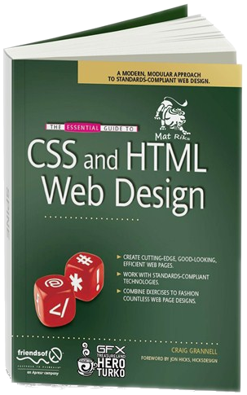

Web Design, HTML, CSS
Web Design, HTML, CSS, Text, Graphics, Links, Tables, Forms, …

Slide 76
Web Design, HTML, CSS
This section consists of the following questions:
Design, development and testing of web sites
Main HTML tags: formatted text insertion, images, links, tables
Web sites styling language CSS
Web site content allignment

Slide 77
Web Design, HTML, CSS (2)
Characteristics of a page (background, color, images, alignment, page titles, page coding, meta tags), paragraphs, fonts, colors, images insertion
Web design conversion (image) web site. Content management systems
Frames. Navigation: Transfer of management to frames

Slide 78
Question
What is the previous version of HTML, prior to HTML5?
HTML 4
HTML 4.9
HTML 4.01
HTML 4.1

Slide 79
Answer
Information:
HTML 4.01 was published in late 1999, with further errata published through 2001. In 2004 development began on HTML5 in the Web Hypertext Application Technology Working Group (WHATWG), which became a joint deliverable with the W3C in 2008.
Source: Wikipedia

Slide 80





JavaScript
Scripts Development with JavaScript, Main JavaScript Constructs , Operators, Objects, Manipulation of DOM Tree

Slide 81
JavaScript
This section consists of the following questions:
Internet programming script languages: JavaScript, Perl, VBScript. JavaScript overview. Data types. Variables. Appropriation operator. Operations and expressions. Conditional operator. Loops operator. JavaScript functions. JavaScript objects. Massives. Date, Math classes. Document, window, navigator Objects. JavaScript events. DOM object model and JavaScript manipulations.

Slide 82
Question
Which of the following is NOT true about JavaScript
JavaScript is the latest version of Java
JavaScript variables are global and local
JavaScript is an interpreted computer programming language
You can use JavaScript code in browser applications together with HTML, CSS and the Document Object Model (DOM)

Slide 83
Answer
Information:
Java is an OOP programming language while Java Script is an OOP scripting language. Java creates applications that run in a virtual machine or browser while JavaScript code is run on a browser only. Java code needs to be compiled while JavaScript code are all in text. They require different plug-ins.
Източник: www.java.com; Wikipedia

Slide 84
Telerik School Academy
?
?
?
?
?
Questions?
?
?
?
?
?
http://schoolacademy.telerik.com

